Slide 1
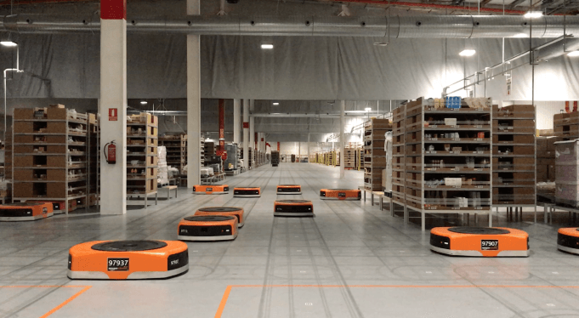
Amazon Robotics machines in a Amazon warehouse
Collision avoidance and coordination for a fleet of robots
Luca Marseglia

Slide 2
Quick roadmap
Collision avoidance strategies
Scaling the maximum velocity along the whole trajectory
Scaling the maximum velocity only along the colliding segments
Brute-force approach
Too slow
Latest-colliding approach
Only works for the last segment
Not optimal
Optimization approach
Prioritized approach
Not optimal
MINLP
2024 August | Slide 2

Slide 3
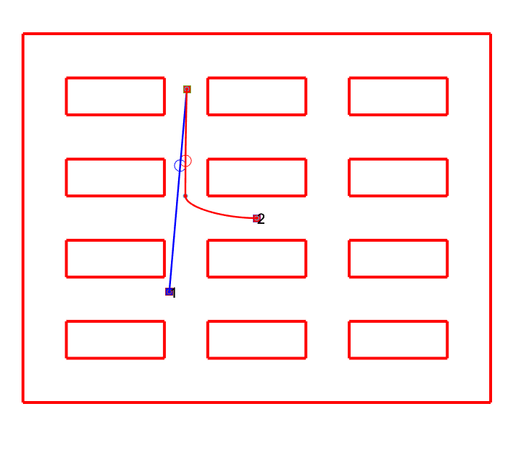
Last meeting
2024 August | Slide 3

Slide 4
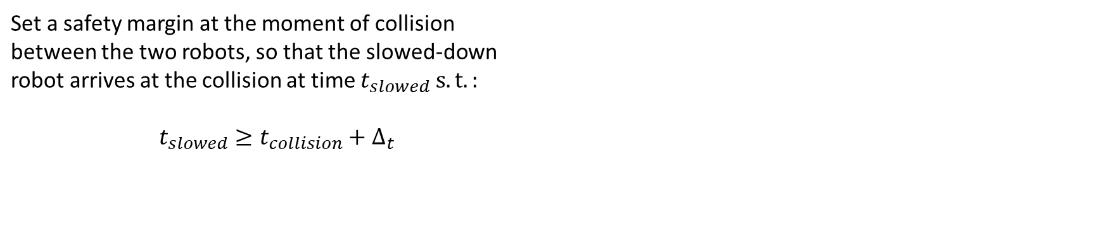

Last meeting
Goal:
Avoid collision between two robots by adding a slow-down segment before the collision
Optimize the time duration of the whole task
Optimization approach:
Set a safety margin at the moment of collision between the two robots, so that the slowed-down robot arrives at the collision at time $t_{slowed} s.t.:$ $$t_{slowed}≥t_{collision}+Δ_{t}$$
$$L_{s}$$
L
2024 August | Slide 4

Slide 5
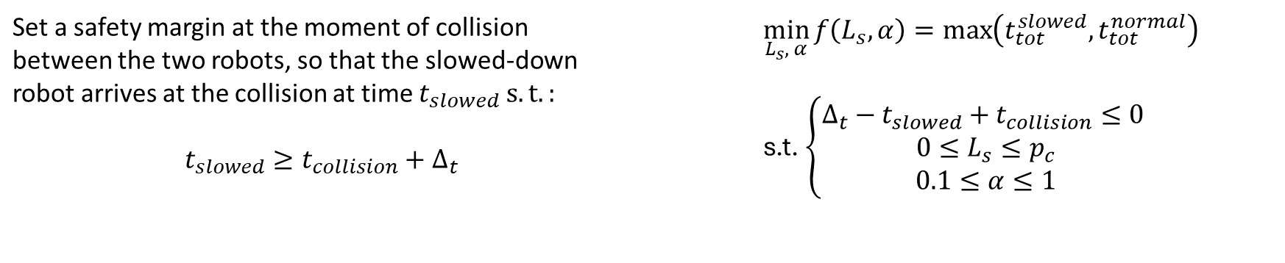
Last meeting
Goal:
Avoid collision between two robots by adding a slow-down segment before the collision
Optimize the time duration of the whole task
Optimization approach:
Set a safety margin at the moment of collision between the two robots, so that the slowed-down robot arrives at the collision at time $t_{slowed} s.t.:$ $$t_{slowed}≥t_{collision}+Δ_{t}$$ | $$\min_{L_{s}, α}{f\left(L_{s},α\right)}=\max\left(t_{tot}^{slowed},t_{tot}^{normal}\right)$$ s.t. $\left\{\begin{aligned}Δ_{t}−t_{slowed}+t_{collision}≤0 \\ 0≤L_{s}≤p_{c} \\ 0.1≤α≤1\end{aligned}\right.$
2024 August | Slide 5

Slide 6
Last meeting
Issue: How to choose which robot to slow down to avoid collision?
2024 August | Slide 6

Slide 7
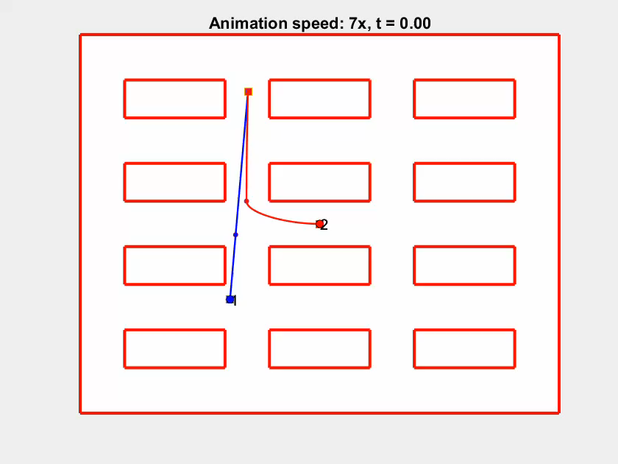
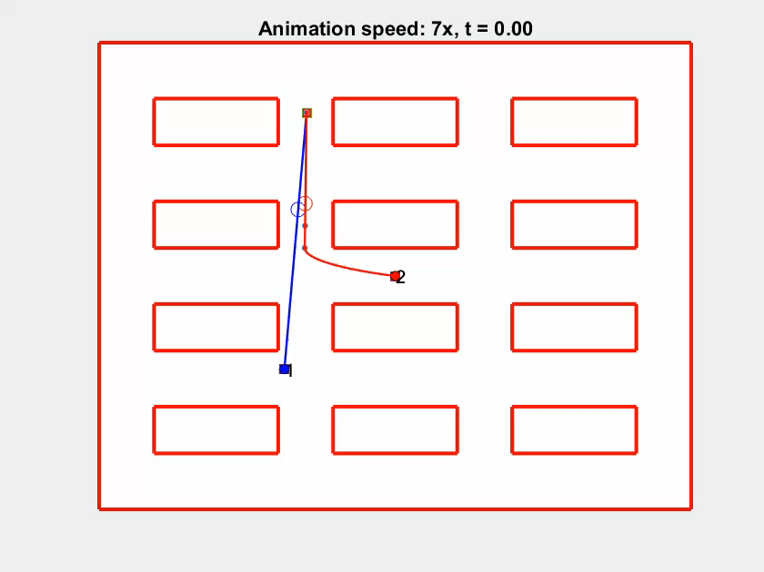
Results for both robots
Slowing down robot 1
Slowing down robot 2
2024 August | Slide 7

Slide 8
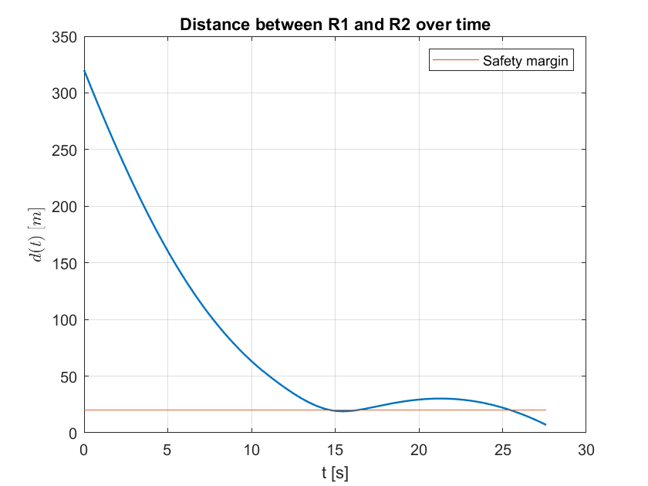
New approach
Issue: With this approach, the collision is only solved at $t_{collision}$
2024 August | Slide 8

Slide 9
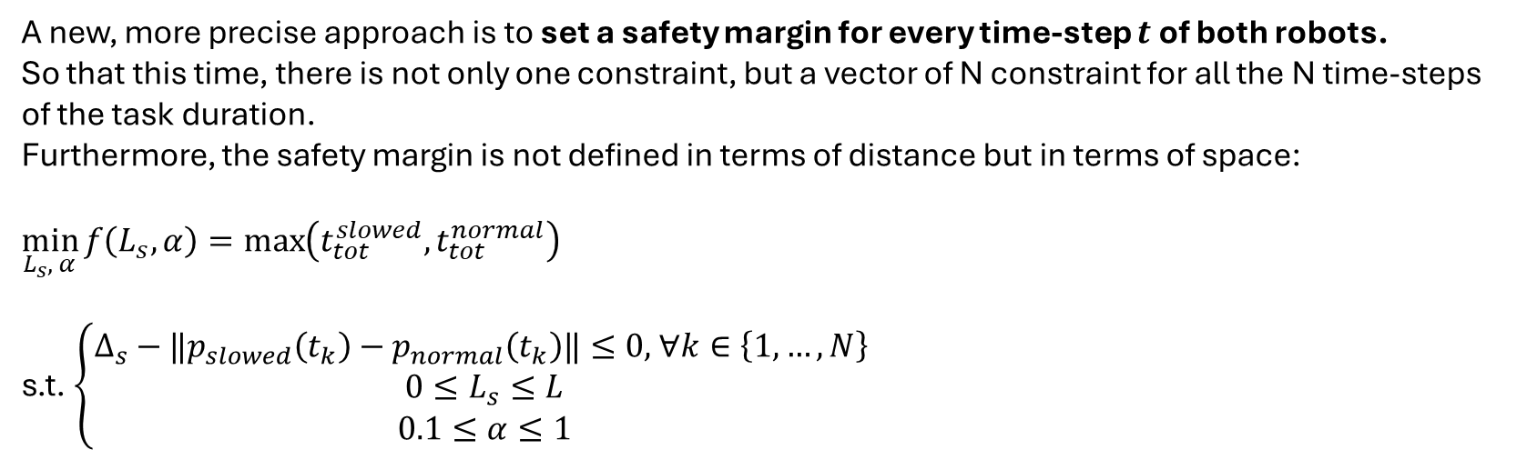
New approach
A new, more precise approach is to set a safety margin for every time-step $t$ of both robots.
So that this time, there is not only one constraint, but a vector of N constraint for all the N time-steps of the task duration.
Furthermore, the safety margin is not defined in terms of distance but in terms of space:
$$\min_{L_{s}, α}{f\left(L_{s},α\right)}=\max\left(t_{tot}^{slowed},t_{tot}^{normal}\right)$$
s.t. $\left\{\begin{aligned}Δ_{s}−‖p_{slowed}\left(t_{k}\right)−p_{normal}\left(t_{k}\right)‖≤0\text{, }∀k∈\left\{\text{1,}…,N\right\} \\ 0≤L_{s}≤L \\ 0.1≤α≤1\end{aligned}\right.$
Also, the length of the slowed-down segment can be taken along the whole colliding segment
2024 August | Slide 9

Slide 10
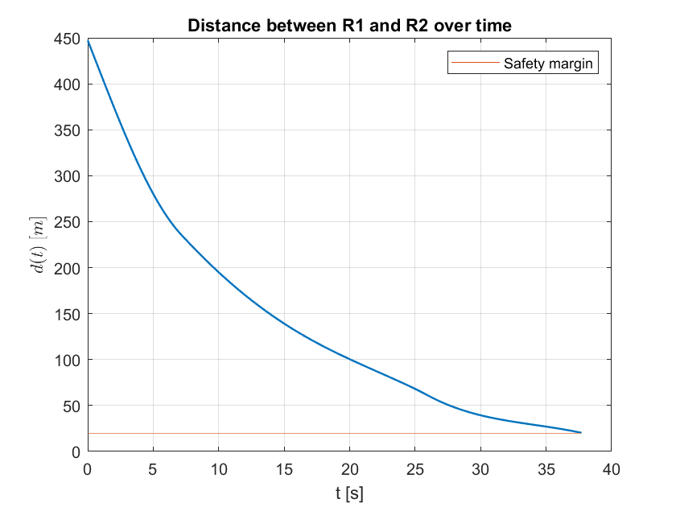
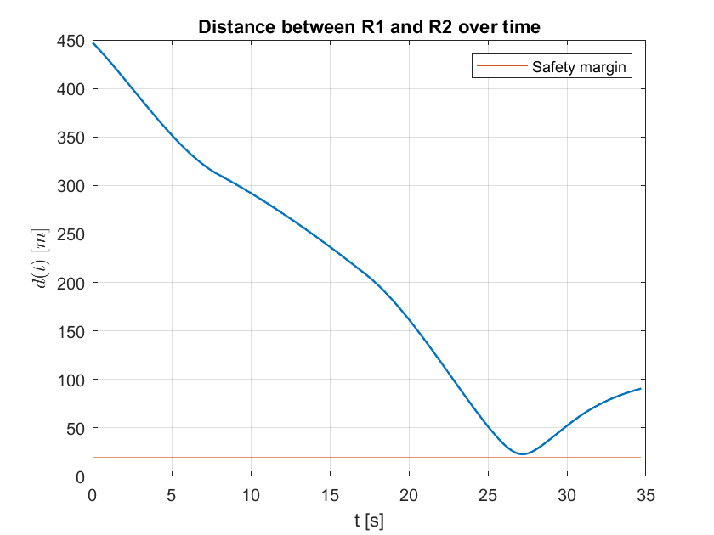
Results
Slowing down robot 1
Slowing down robot 2
2024 August | Slide 10

Slide 11
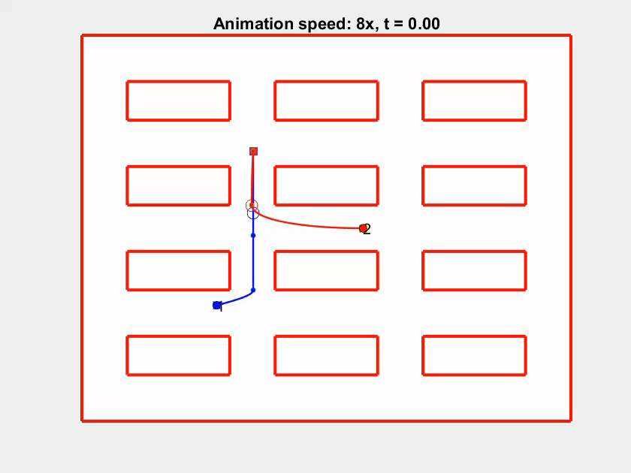

Results
Slowing down robot 1
Slowing down robot 2
2024 August | Slide 11

Slide 12
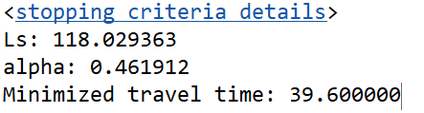
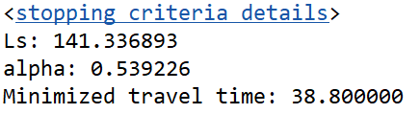
Results
Slowing down robot 1
Slowing down robot 2
2024 August | Slide 12

Slide 13
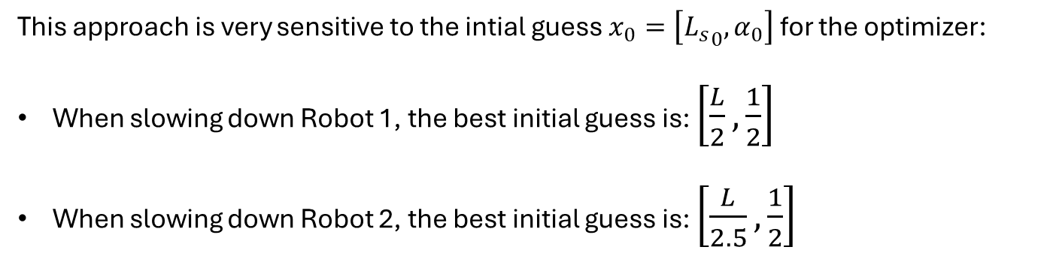
Issue: Initial guess
This approach is very sensitive to the intial guess $x_{0}=\left[{L_{s}}_{0},α_{0}\right]$ for the optimizer:
When slowing down Robot 1, the best initial guess is: $\left[\frac{L}{2},\frac{1}{2}\right]$
When slowing down Robot 2, the best initial guess is: $\left[\frac{L}{2.5},\frac{1}{2}\right]$
2024 August | Slide 13

Slide 14
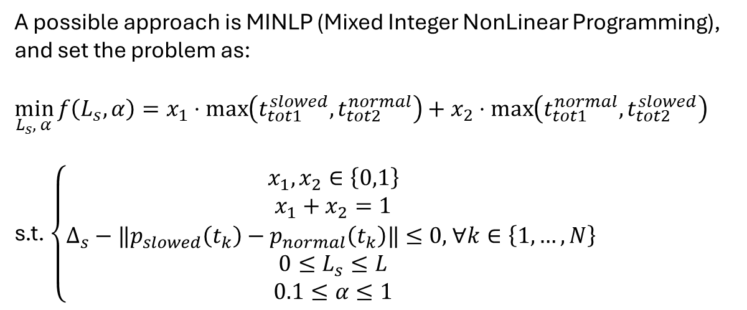
Issue: How to choose which robot to slow down?
A possible approach is MINLP (Mixed Integer NonLinear Programming), and set the problem as:
$$\min_{L_{s}, α}{f\left(L_{s},α\right)}=x_{1}⋅\max\left(t_{tot1}^{slowed},t_{tot2}^{normal}\right)+x_{2}⋅\max\left(t_{tot1}^{normal},t_{tot2}^{slowed}\right)$$
s.t. $\left\{\begin{aligned}\begin{aligned}x_{1},x_{2}∈\left\{0,1\right\} \\ x_{1}+x_{2}=1 \\ Δ_{s}−‖p_{slowed}\left(t_{k}\right)−p_{normal}\left(t_{k}\right)‖≤0\text{, }∀k∈\left\{\text{1,}…,N\right\} \end{aligned} \\ 0≤L_{s}≤L \\ 0.1≤α≤1\end{aligned}\right.$
But MATLAB does not offer any solver for a mixed approach (either continous or integer).
So the solution would be to first solve the problem with FMINCON and the with INTLINCON,
Using the results of FMINCON as fixed weights…
2024 August | Slide 14

